Slide 1





“Statement or quotation here Statement or quotation here Statement or quotation here Statement or quotation here Statement or quotation here Statement or quotation here.”
Notes:
Quote in perspective
(Basic)
To reproduce the effects on this slide, do the following:
On the Home tab, in the Slides group, click Layout, and then click Blank.
On the Insert tab, in the Text group, click Text Box, and then on the slide, drag to draw the text box.
Enter text in the text box, select the text, and then on the Home tab, in the Font group, select Georgia from the Font list, enter 27 in the Font Size box, and then click Italic.
On the Home tab, in the Paragraph group, click Align Text Left to align the text left in the text box.
Select the text box. Under Drawing Tools, on the Format tab, in the WordArt Styles group, click the arrow next to Text Fill, and then under Theme Colors click White, Background 1 (first row, first option from the left).
Under Drawing Tools, on the Format tab, in the WordArt Styles group, click Text Effects, point to 3-D Rotation, and then under Perspective, click Perspective Relaxed Moderately (second row, second option from the left).
Under Drawing Tools, on the Format tab, in the WordArt Styles group, click Text Effects, point to 3-D Rotation, and then click 3-D Rotation Options.
In the Format Text Effects dialog box, click 3-D Rotation in the left pane, and then do the following in the right pane:
In the Y box, enter 324.8°.
In the Perspective box, enter 80°.
To reproduce the background on this slide, do the following:
Right-click the slide background area, and then click Format Background. In the Format Background dialog box, click Fill in the left pane, and then in the right pane click Picture or texture fill.
Under Insert from, click File.
In the Insert Picture dialog box, select a picture and then click Insert.

Slide 2

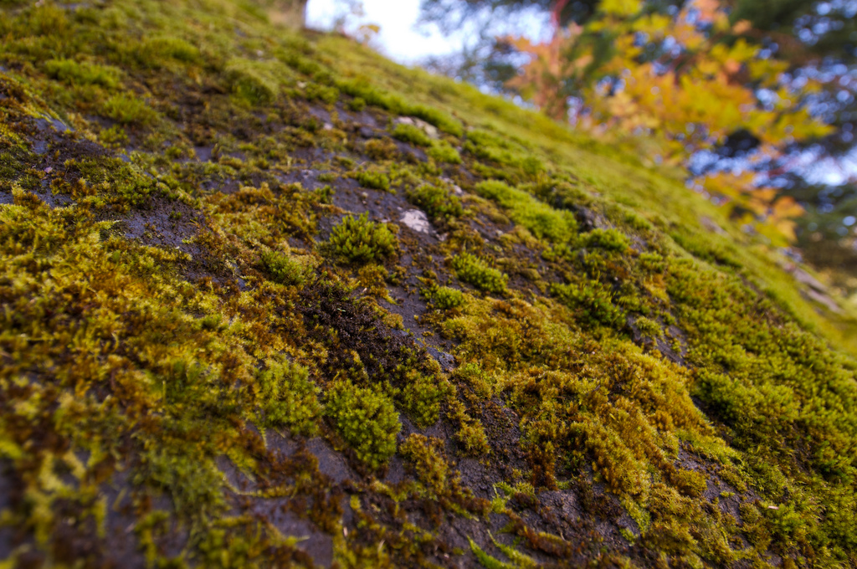
:
10
09
08
07
06
05
04
03
02
01
00
Time for a short break
Notes:
Custom animation effects: countdown
(Advanced)
Tip: For the effects on this slide, use a large picture that measures 7.5” high and 10” wide (the dimensions of the slide).
To reproduce the animated picture effects on this slide, do the following:
On the Home tab, in the Slides group, click Layout, and then click Blank.
On the Insert tab, in the Illustrations group, click Picture. In the Insert Picture dialog box, select the 7.5” x 10” picture, and then click Insert.
On the slide, select the picture. Under Picture Tools, on the Format tab, in the bottom right corner of the Size group, click the Size and Position dialog box launcher. In the Size and Position dialog box, on the Size tab, under Crop from, in the Right box, enter 5.33”. (Note: Under Size and rotate, the Height should now be 7.5” and the Width should now be 5”.)
On the Home tab, in the Drawing group, click Arrange, point to Align, and then do the following:
Click Align to Slide.
Click Align Left.
Click Align Middle.
On the Insert tab, in the Illustrations group, click Picture. In the Insert Picture dialog box, select the same 7.5” x 10” picture, and then click Insert.
On the slide, select the second picture. Under Picture Tools, on the Format tab, in the bottom right corner of the Size group, click the Size and Position dialog box launcher. In the Size and Position dialog box, on the Size tab, under Crop from, in the Left box, enter 5.33”. (Note: Under Size and rotate, the Height should be 7.5” and the Width should now be 5”.)
On the Home tab, in the Drawing group, click Arrange, point to Align, and then do the following:
Click Align to Slide.
Click Align Right.
Click Align Middle.
On the Home tab, in the Drawing group, click Shapes, and then under Rectangle click Rectangle (first option from the left). On the slide, drag to draw a rectangle.
Select the rectangle. On the Home tab, in the Drawing group, click Arrange, point to Align, and then do the following:
Click Align to Slide.
Click Align Right.
Click Align Middle.
With the rectangle still selected, on the Home tab, in the bottom right corner of the Drawing group, click the Format Shape dialog box launcher. In the Format Shape dialog box, click Fill in the left pane. In the Fill pane, select Solid fill, and then do the following:
Click the button next to Color, and then under Theme Colors click White, Background 1 (first row, first option from the left).
In the Transparency box, enter 10%.
On the Animations tab, in the Animations group, click Custom Animation.
On the slide, select the left picture. In the Custom Animation task pane, do the following:
Click Add Effect, point to Entrance, and then click More Effects. In the Add Entrance Effect dialog box, under Basic, click Peek In.
Select the animation effect (peek-in effect for the left picture). Under Modify: Peek In, do the following:
In the Start list, select With Previous.
In the Direction list, select From Right.
In the Speed list, select Medium.
On the slide, select the second (right) picture. In the Custom Animation task pane, do the following:
Click Add Effect, point to Entrance, and then click More Effects. In the Add Entrance Effect dialog box, under Basic, click Peek In.
Select the second animation effect (peek-in effect for the right picture). Under Modify: Peek In, do the following:
In the Start list, select With Previous.
In the Direction list, select From Left.
In the Speed list, select Medium.
To reproduce the first animated text effects on this slide, do the following:
On the Insert tab, in the Text group, click Text Box. On the slide, drag to draw a text box.
Enter Time for a short break in the text box.
Select the text. On the Home tab, in the Font group, do the following:
In the Font list, select TW Cen MT.
In the Font Size list, select 40.
Click Bold.
Click the arrow next to Font Color, and then under Theme Colors click White, Background 1 (first row, first option from the left).
On the Home tab, in the Paragraph group, click Align Text Right to align the text right in the text box.
On the text box, drag the adjustment handles to adjust the size of the text box so that the text wraps onto two lines, as in the example above.
Drag the text box onto the lower half of the slide, to the left of the middle.
On the slide, select the text box. In the Custom Animation task pane, do the following:
Click Add Effect, point to Entrance, and then click More Effects. In the Add Entrance Effect dialog box, under Moderate, click Ascend.
Select the third animation effect (ascend effect for the first text box). Click the arrow to the right of the selected effect, and then click Timing. In the Ascend dialog box, do the following:
In the Start list, select With Previous.
In the Delay box, enter 1.
In the Speed list, select 1 seconds (Fast).
To reproduce the other animated text effects on this slide, do the following:
On the Insert tab, in the Text group, click Text Box. On the slide, drag to draw a text box.
Enter : in the second text box.
Select the text in the second text box. On the Home tab, in the Font group, do the following:
In the Font list, select TW Cen MT.
In the Font Size list, select 90.
Click Bold.
Click the arrow next to Font Color, and then under Theme Colors click Black, Text 1 (first row, second option from the left).
On the Home tab, in the Paragraph group, click Align Text Left to align the colon left in the second text box.
Drag the second text box into the upper half of the slide, to the right of the middle.
On the slide, select the second text box. In the Custom Animation task pane, do the following:
Click Add Effect, point to Entrance, and then click More Effects. In the Add Entrance Effect dialog box, under Moderate, click Descend.
Select the fourth animation effect (descend effect for the second text box). Under Modify: Descend, do the following:
In the Start list, select With Previous.
In the Speed list, select Fast.
On the slide, select the second text box. On the Home tab, in the Clipboard group, click the arrow under Paste, and then click Duplicate.
Click in the third text box, delete the colon, and then enter 10.
Drag the 10 text box on top of the second text box, until the number is positioned to the right of the colon.
On the Home tab, in the Editing group, click Select, and then click Selection Pane.
In the Selection and Visibility pane, select the 10 text box. In the Custom Animation task pane, do the following:
Click Add Effect, point to Exit, and then click More Effects. In the Add Exit Effect dialog box, under Basic, click Disappear.
Select the sixth animation effect (disappear effect for the second text box). Click the arrow to the right of the selected effect, and then click Timing. In the Disappear dialog box, on the Timing tab, do the following:
In the Start list, select After Previous.
In the Delay box, enter 1.
In the Selection and Visibility pane, select the 10 text box. On the Home tab, in the Clipboard group, click the arrow under Paste, and then click Duplicate.
Click in the fourth text box, delete 10, and then enter 09 (the content of the previous text box, minus one second).
In the Selection and Visibility pane, select the 09 text box. On the slide, drag the selected text box on top of the other text boxes.
In the Custom Animation task pane, do the following:
Select the seventh animation effect (descend effect for the 09 text box). Click Change, point to Entrance, and then click More Effects. In the Change Entrance Effect dialog box, under Basic, click Appear.
Select the seventh animation effect (appear effect for the 09 text box). Click the arrow to the right of the selected effect, and then click Timing. In the Appear dialog box, on the Timing tab, in the Delay box, enter 1.
In the Selection and Visibility pane, select the 09 text box. On the Home tab, in the Clipboard group, click the arrow under Paste, and then click Duplicate.
On the slide, click in the duplicate text box, delete 09, and enter 08 (the content of the previous text box, minus one second).
In the Selection and Visibility pane, select the 08 text box. On the slide, drag the selected text box on top of the other text boxes.
On the slide, continue to duplicate, edit, and drag the text boxes as in steps 16-18, entering a number in each new text box that is one second less than the previous text box, until there is a total of 11 numbered text boxes. (Note: The final text box will contain 00).
In the Custom Animation task pane, select the last animation effect (disappear effect for the 00 text box), and then click Remove.

Slide 3

Shifting Phenology
Notes:
Asset Type: Assessment
Notes for Teacher - < Information for further reference or explanation >
Suggestions: <Ideas/ Images/ Animations / Others – To make better representation of the content >
Details of Multimedia Objects (Image/audio/ Video/Animation) used in this slide -
1. <Short Description> - <SOURCE TYPE> <SOURCE URL>
e.g. Gandhiji- CR FREE CREATIVE COMMONS SEARCH - http://en.wikipedia.org/wiki/File:Portrait_Gandhi.jpg
Source Types -
SSSVV GALLERY
ORIGINAL (SELF CLICKED)
ORIGINAL (USING SHAPES/Ms PPT FEATURES)
ORIGINAL (USING PHOTOSHOP/HAND DRAWN SKETCH)
CR FREE CREATIVE COMMONS SEARCH
SSSVV AUTHORIZED LINKS
Others

Slide 4

Changing Phenology
Introduction
Notes:
Custom animation effects: rise up and shrink
(Basic)
To reproduce the rectangle on this slide, do the following:
On the Home tab, in the Slides group, click Layout, and then click Blank.
On the Home tab, in the Drawing group, click Shapes, and then under Rectangles click Rectangle (first option from the left). On the slide, drag to draw a rectangle.
Select the rectangle. Under Drawing Tools, on the Format tab, in the Size group, do the following:
In the Shape Height box, enter 3”.
In the Shape Width box, enter 10”.
With the rectangle still selected, on the Home tab, in the Drawing group, do the following:
Click the arrow next to Shape Fill, and then under Theme Colors click Black, Text 1, Lighter 5% (sixth row, second option from the left).
Click the arrow next to Shape Outline, and then click No Outline.
On the Home tab, in the Drawing group, click Arrange, point to Align, and then do the following:
Click Align to Slide.
Click Align Top.
Click Align Center.
To reproduce the text on this slide, do the following:
On the Insert tab, in the Text group, click Text Box, and then on the slide, drag to draw a text box.
Enter text in the text box and select the text. On the Home tab, in the Font group, do the following:
In the Font list, select Arial Black.
In the Font Size box, enter 38.
Click Bold.
On the Home tab, in the Paragraph group, click Center to center the text in the text box.
Select the text box. Under Drawing Tools, on the Format tab, in the bottom right corner of the WordArt Styles group, click the Format Text Effects dialog box launcher. In the Format Text Effects dialog box, click Text Fill in the left pane, select Gradient fill in the Text Fill pane, and then do the following:
In the Type list, select Linear.
Click the button next to Direction, and then click Linear Down (first row, second option from the left).
Under Gradient stops, click Add or Remove until three stops appear in the drop-down list.
Also under Gradient stops, customize the gradient stops that you added as follows:
Select Stop 1 from the list, and then do the following:
In the Stop position box, enter 0%.
Click the button next to Color, click More Colors, and then in the Colors dialog box, on the Custom tab, enter values for Red: 255, Green: 214, Blue: 63.
Select Stop 2 from the list, and then do the following:
In the Stop position box, enter 75%.
Click the button next to Color, click More Colors, and then in the Colors dialog box, on the Custom tab, enter values for Red: 255, Green: 192, Blue: 0.
Select Stop 3 from the list, and then do the following:
In the Stop position box, enter 100%.
Click the button next to Color, click More Colors, and then in the Colors dialog box, on the Custom tab, enter values for Red: 255, Green: 162, Blue: 96.
Also in the Format Text Effects dialog box, click Shadow in the left pane. In the Shadow pane, click the button next to Presets, under Outer click Offset Bottom (first row, second option from the left), and then do the following:
In the Transparency box, enter 70%.
In the Size box, enter 100%.
In the Blur box, enter 6.3 pt.
In the Angle box, enter 84°.
In the Distance box, enter 3.2 pt.
Also in the Format Text Effects dialog box, click 3-D Format in the left pane, and then do the following in the 3-D Format pane:
Under Bevel, click the button next to Top, and then under Bevel click Circle (first row, first option from the left). Next to Top, in the Width box, enter 2 pt, and in the Height box, enter 2 pt.
Under Contour, click the button next to Color, click More Colors, and then in the Colors dialog box, on the Custom tab, enter values for Red: 215, Green: 130, Blue: 60. In the Size box, enter 1 pt.
Under Surface, in the Material list, under Standard, select Warm Matte (second option from the left). In the Lighting list, under Special, select Glow (third option from the left). In the Angle box, enter 90°.
On the slide, drag the text box just above the bottom edge of the rectangle.
With the text box still selected, on the Home tab, in the Drawing group, click Arrange, point to Align, and then do the following:
Click Align to Slide.
Click Align Center.
To reproduce the line on this slide, do the following:
On the Home tab, in the Drawing group, click Shapes, and then under Lines click Line (first option from the left). On the slide, press and hold SHIFT, and then drag to draw a straight, horizontal line.
Select the line. Under Drawing Tools, on the Format tab, in the Size group, in the Shape Width box, enter 10”.
Under Drawing Tools, on the Format tab, in the bottom right corner of the Shape Styles group, click the Format Shape dialog box launcher. In the Format Shape dialog box, click Line Color in the left pane. In the Line Color pane, select Solid fill, click the button next to Color, and then select More Colors. In the Colors dialog box, on the Custom tab, enter values for Red: 255, Green: 232, Blue: 63.
Also in the Format Shape dialog box, click Line Style in the left pane. In the Line Style pane, in the Width box, enter 4.5 pt.
Also in the Format Shape dialog box, click 3-D Format in the left pane. In the 3-D Format pane, under Bevel, do the following:
Click the button next to Top, and then under Bevel click Circle (first row, first option from the left).
Next to Top, in the Width box, enter 3 pt.
Next to Top, in the Height box, enter 6 pt.
On the slide, drag the line until the top edge touches the bottom edge of the rectangle.
On the Home tab, in the Drawing group, click Arrange, point to Align, and then do the following:
Click Align to Slide.
Click Align Center.
To reproduce the animation effects on this slide, do the following:
On the Animations tab, in the Animations group, click Custom Animation.
On the slide, select the text box. In the Custom Animation task pane, do the following:
Click Add Effect, point to Exit, and then click More Effects. In the Add Exit Effect dialog box, under Basic, click Disappear.
Select the animation effect (disappear effect for the text box). Under Modify: Disappear, in the Start list, select After Previous.
On the slide, select the text box. In the Custom Animation task pane, do the following:
Click Add Effect, point to Emphasis, and then click More Effects. In the Add Emphasis Effect dialog box, under Basic, click Grow/Shrink.
Select the second animation effect (grow/shrink effect for the text box). Click the arrow to the right of the effect, and then click Effect Options. In the Grow/Shrink dialog box, do the following:
On the Effect tab, in the Size list, in the Custom box, enter 400%, and then press ENTER. Also in the Size list, click Vertical.
On the Timing tab, do the following:
In the Start list, select After Previous.
In the Speed box, enter 0.01 seconds.
On the slide, select the text box. In the Custom Animation task pane, do the following:
Click Add Effect, point to Entrance, and then click More Effects. In the Add Entrance Effect dialog box, under Basic, click Appear.
Select the third animation effect (appear effect for the text box). Under Modify: Appear, in the Start list, select After Previous.
On the slide, select the text box. In the Custom Animation task pane, do the following:
Click Add Effect, point to Emphasis, and then click More Effects. In the Add Emphasis Effect dialog box, under Basic, click Grow/Shrink.
Select the fourth animation effect (grow/shrink effect for the text box). Click the arrow to the right of the effect, and then click Effect Options. In the Grow/Shrink dialog box, do the following:
On the Effect tab, in the Size list, in the Custom box, enter 25%, and then press ENTER. Also in the Size list, click Vertical.
On the Timing tab, do the following:
In the Start list, select With Previous.
In the Speed list, select 1 seconds (Fast).
On the slide, select the text box. In the Custom Animation task pane, do the following:
Click Add Effect, point to Entrance, and then click More Effects. In the Add Entrance Effect dialog box, under Moderate, click Rise Up.
Select the fifth animation effect (rise-up effect for the text box). Under Modify: Rise Up, do the following:
In the Start list, select With Previous.
In the Speed list, select Fast.
On the slide, press and hold CTRL, and then select the rectangle and the line. In the Custom Animation task pane, do the following:
Click Add Effect, point to Entrance, and then click More Effects. In the Add Entrance Effect dialog box, under Moderate, click Descend.
Press and hold CTRL, and then select the sixth and seventh animation effects (descend effects for the rectangle and the line). Under Modify: Descend, do the following:
In the Start list, select With Previous.
In the Speed list, select Fast.
To reproduce the background effects on this slide, do the following:
Right-click the slide background area, and then click Format Background. In the Format Background dialog box, click Fill in the left pane, select Gradient fill in the Fill pane, and then do the following:
In the Type list, select Linear.
Click the button next to Direction, and then click Linear Up (second row, second option from the left).
Under Gradient stops, click Add or Remove until two stops appear in the drop-down list.
Also under Gradient stops, customize the gradient stops that you added as follows:
Select Stop 1 from the list, and then do the following:
In the Stop position box, enter 0%.
Click the button next to Color, and then under Theme Colors click Black, Text 1, Lighter 15% (fifth row, second option from the left).
Select Stop 2 from the list, and then do the following:
In the Stop position box, enter 100%.
Click the button next to Color, and then under Theme Colors click Black, Text 1, Lighter 50% (second row, second option from the left).

Slide 5
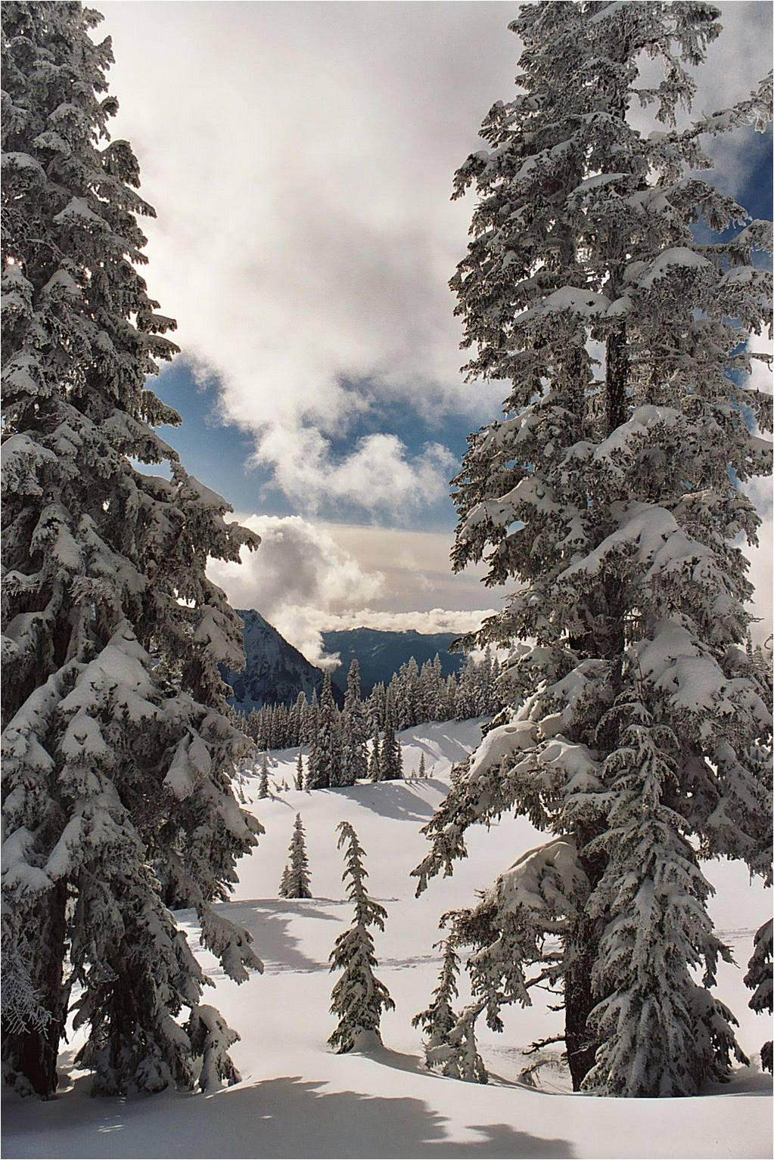


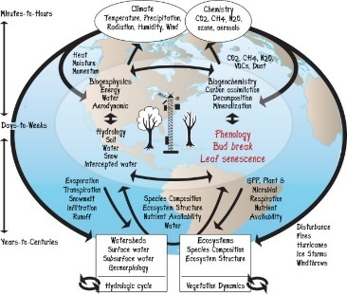
Changing Phenology
Climate change has led to shifts in phenology in many species distributed widely across taxonomic groups. It is, however, unclear how we should interpret these shifts without some sort of a yardstick
Thus, many species are becoming mistimed due to climate change. We urge researchers with long-term datasets on phenology to link their data with those that may serve as a yardstick, because documentation of the incidence of climate change-induced mistiming is crucial in assessing the impact of global climate change.
Introduction
Phenology is the study of periodic plant and animal life cycle events and how these are influenced by seasonal and inter annual variations in climate, as well as habitat factors
Notes:
Custom animation effects: rise up and shrink
(Basic)
To reproduce the rectangle on this slide, do the following:
On the Home tab, in the Slides group, click Layout, and then click Blank.
On the Home tab, in the Drawing group, click Shapes, and then under Rectangles click Rectangle (first option from the left). On the slide, drag to draw a rectangle.
Select the rectangle. Under Drawing Tools, on the Format tab, in the Size group, do the following:
In the Shape Height box, enter 3”.
In the Shape Width box, enter 10”.
With the rectangle still selected, on the Home tab, in the Drawing group, do the following:
Click the arrow next to Shape Fill, and then under Theme Colors click Black, Text 1, Lighter 5% (sixth row, second option from the left).
Click the arrow next to Shape Outline, and then click No Outline.
On the Home tab, in the Drawing group, click Arrange, point to Align, and then do the following:
Click Align to Slide.
Click Align Top.
Click Align Center.
To reproduce the text on this slide, do the following:
On the Insert tab, in the Text group, click Text Box, and then on the slide, drag to draw a text box.
Enter text in the text box and select the text. On the Home tab, in the Font group, do the following:
In the Font list, select Arial Black.
In the Font Size box, enter 38.
Click Bold.
On the Home tab, in the Paragraph group, click Center to center the text in the text box.
Select the text box. Under Drawing Tools, on the Format tab, in the bottom right corner of the WordArt Styles group, click the Format Text Effects dialog box launcher. In the Format Text Effects dialog box, click Text Fill in the left pane, select Gradient fill in the Text Fill pane, and then do the following:
In the Type list, select Linear.
Click the button next to Direction, and then click Linear Down (first row, second option from the left).
Under Gradient stops, click Add or Remove until three stops appear in the drop-down list.
Also under Gradient stops, customize the gradient stops that you added as follows:
Select Stop 1 from the list, and then do the following:
In the Stop position box, enter 0%.
Click the button next to Color, click More Colors, and then in the Colors dialog box, on the Custom tab, enter values for Red: 255, Green: 214, Blue: 63.
Select Stop 2 from the list, and then do the following:
In the Stop position box, enter 75%.
Click the button next to Color, click More Colors, and then in the Colors dialog box, on the Custom tab, enter values for Red: 255, Green: 192, Blue: 0.
Select Stop 3 from the list, and then do the following:
In the Stop position box, enter 100%.
Click the button next to Color, click More Colors, and then in the Colors dialog box, on the Custom tab, enter values for Red: 255, Green: 162, Blue: 96.
Also in the Format Text Effects dialog box, click Shadow in the left pane. In the Shadow pane, click the button next to Presets, under Outer click Offset Bottom (first row, second option from the left), and then do the following:
In the Transparency box, enter 70%.
In the Size box, enter 100%.
In the Blur box, enter 6.3 pt.
In the Angle box, enter 84°.
In the Distance box, enter 3.2 pt.
Also in the Format Text Effects dialog box, click 3-D Format in the left pane, and then do the following in the 3-D Format pane:
Under Bevel, click the button next to Top, and then under Bevel click Circle (first row, first option from the left). Next to Top, in the Width box, enter 2 pt, and in the Height box, enter 2 pt.
Under Contour, click the button next to Color, click More Colors, and then in the Colors dialog box, on the Custom tab, enter values for Red: 215, Green: 130, Blue: 60. In the Size box, enter 1 pt.
Under Surface, in the Material list, under Standard, select Warm Matte (second option from the left). In the Lighting list, under Special, select Glow (third option from the left). In the Angle box, enter 90°.
On the slide, drag the text box just above the bottom edge of the rectangle.
With the text box still selected, on the Home tab, in the Drawing group, click Arrange, point to Align, and then do the following:
Click Align to Slide.
Click Align Center.
To reproduce the line on this slide, do the following:
On the Home tab, in the Drawing group, click Shapes, and then under Lines click Line (first option from the left). On the slide, press and hold SHIFT, and then drag to draw a straight, horizontal line.
Select the line. Under Drawing Tools, on the Format tab, in the Size group, in the Shape Width box, enter 10”.
Under Drawing Tools, on the Format tab, in the bottom right corner of the Shape Styles group, click the Format Shape dialog box launcher. In the Format Shape dialog box, click Line Color in the left pane. In the Line Color pane, select Solid fill, click the button next to Color, and then select More Colors. In the Colors dialog box, on the Custom tab, enter values for Red: 255, Green: 232, Blue: 63.
Also in the Format Shape dialog box, click Line Style in the left pane. In the Line Style pane, in the Width box, enter 4.5 pt.
Also in the Format Shape dialog box, click 3-D Format in the left pane. In the 3-D Format pane, under Bevel, do the following:
Click the button next to Top, and then under Bevel click Circle (first row, first option from the left).
Next to Top, in the Width box, enter 3 pt.
Next to Top, in the Height box, enter 6 pt.
On the slide, drag the line until the top edge touches the bottom edge of the rectangle.
On the Home tab, in the Drawing group, click Arrange, point to Align, and then do the following:
Click Align to Slide.
Click Align Center.
To reproduce the animation effects on this slide, do the following:
On the Animations tab, in the Animations group, click Custom Animation.
On the slide, select the text box. In the Custom Animation task pane, do the following:
Click Add Effect, point to Exit, and then click More Effects. In the Add Exit Effect dialog box, under Basic, click Disappear.
Select the animation effect (disappear effect for the text box). Under Modify: Disappear, in the Start list, select After Previous.
On the slide, select the text box. In the Custom Animation task pane, do the following:
Click Add Effect, point to Emphasis, and then click More Effects. In the Add Emphasis Effect dialog box, under Basic, click Grow/Shrink.
Select the second animation effect (grow/shrink effect for the text box). Click the arrow to the right of the effect, and then click Effect Options. In the Grow/Shrink dialog box, do the following:
On the Effect tab, in the Size list, in the Custom box, enter 400%, and then press ENTER. Also in the Size list, click Vertical.
On the Timing tab, do the following:
In the Start list, select After Previous.
In the Speed box, enter 0.01 seconds.
On the slide, select the text box. In the Custom Animation task pane, do the following:
Click Add Effect, point to Entrance, and then click More Effects. In the Add Entrance Effect dialog box, under Basic, click Appear.
Select the third animation effect (appear effect for the text box). Under Modify: Appear, in the Start list, select After Previous.
On the slide, select the text box. In the Custom Animation task pane, do the following:
Click Add Effect, point to Emphasis, and then click More Effects. In the Add Emphasis Effect dialog box, under Basic, click Grow/Shrink.
Select the fourth animation effect (grow/shrink effect for the text box). Click the arrow to the right of the effect, and then click Effect Options. In the Grow/Shrink dialog box, do the following:
On the Effect tab, in the Size list, in the Custom box, enter 25%, and then press ENTER. Also in the Size list, click Vertical.
On the Timing tab, do the following:
In the Start list, select With Previous.
In the Speed list, select 1 seconds (Fast).
On the slide, select the text box. In the Custom Animation task pane, do the following:
Click Add Effect, point to Entrance, and then click More Effects. In the Add Entrance Effect dialog box, under Moderate, click Rise Up.
Select the fifth animation effect (rise-up effect for the text box). Under Modify: Rise Up, do the following:
In the Start list, select With Previous.
In the Speed list, select Fast.
On the slide, press and hold CTRL, and then select the rectangle and the line. In the Custom Animation task pane, do the following:
Click Add Effect, point to Entrance, and then click More Effects. In the Add Entrance Effect dialog box, under Moderate, click Descend.
Press and hold CTRL, and then select the sixth and seventh animation effects (descend effects for the rectangle and the line). Under Modify: Descend, do the following:
In the Start list, select With Previous.
In the Speed list, select Fast.
To reproduce the background effects on this slide, do the following:
Right-click the slide background area, and then click Format Background. In the Format Background dialog box, click Fill in the left pane, select Gradient fill in the Fill pane, and then do the following:
In the Type list, select Linear.
Click the button next to Direction, and then click Linear Up (second row, second option from the left).
Under Gradient stops, click Add or Remove until two stops appear in the drop-down list.
Also under Gradient stops, customize the gradient stops that you added as follows:
Select Stop 1 from the list, and then do the following:
In the Stop position box, enter 0%.
Click the button next to Color, and then under Theme Colors click Black, Text 1, Lighter 15% (fifth row, second option from the left).
Select Stop 2 from the list, and then do the following:
In the Stop position box, enter 100%.
Click the button next to Color, and then under Theme Colors click Black, Text 1, Lighter 50% (second row, second option from the left).

Slide 6
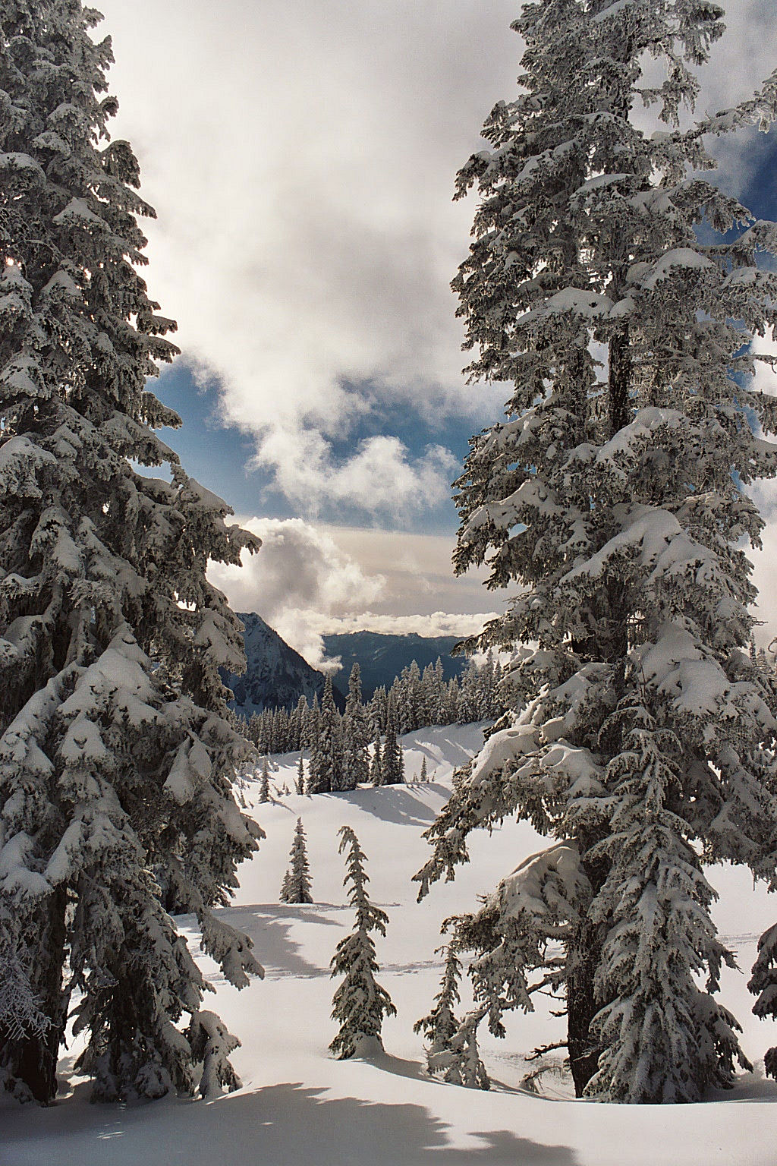
Is April
Change In Phenology
The new way
Notes:
Custom animation effects: picture pan in window with text fade-in and fade-out
(Advanced)
Tip: For best results, select a high-resolution, vertically oriented picture, where the picture height is larger than the slide height. The picture in the example above is 15” high and 10” wide. (Normal slide dimensions are 7.5” high and 10” wide.)
To reproduce the picture effects on this slide, do the following:
On the Home tab, in the Slides group, click Layout, and then click Blank.
On the Insert tab, in the Illustrations group, click Picture. In the Insert Picture dialog box, select a picture, and then click Insert.
Select the picture. Under Picture Tools, on the Format tab, in the bottom right corner of the Size group, click the Size and Position dialog box launcher. In the Size and Position dialog box, on the Size tab, resize or crop the picture as needed so that under Size and rotate, the Height box is set to 15” and the Width box is set to 10”. Resize the picture under Size and rotate by entering values into the Height and Width boxes. Crop the picture under Crop from by entering values into the Left, Right, Top, and Bottom boxes.
On the Home tab, in the Drawing group, click Arrange, point to Align, and then do the following:
Click Align to Slide.
Click Align Top.
Click Align Center.
The remainder of picture will extend beyond the bottom edge of the slide area. You may need to zoom out to view your slide. To zoom out, on the View tab, in the Zoom group, click Zoom. In the Zoom dialog box, select 33%.
To reproduce the shape effects on this slide, do the following:
On the Home tab, in the Drawing group, click Shapes, and then under Rectangles click Rounded Rectangle (second option from the left). On the slide, drag to draw a rounded rectangle.
Select the rounded rectangle. Under Drawing Tools, on the Format tab, in the Size group, do the following:
In the Shape Height box, enter 2.5”.
In the Shape Width box, enter 8”.
Under Drawing Tools, on the Format tab, in the Shape Styles group, do the following:
Click the arrow next to Shape Fill, and then click No Fill.
Click the arrow next to Shape Outline, and then under Theme Colors click White, Background 1 (first row, first option from the left).
Under Drawing Tools, on the Format tab, in the bottom right corner of the Shape Styles group, click the Format Shape dialog box launcher. In the Format Shape dialog box, in the left pane, click Line Style. In the Line Style pane, in the Width box, enter 10 pt.
Also in the Format Shape dialog box, in the left pane, click 3-D Format, and then do the following in the 3-D Format pane:
Under Bevel, click the button next to Top, and then under Bevel click Circle (first row, first option from the left).
Under Surface, click the button next to Material, and then under Standard click Warm Matte (second option from the left). Click the button next to Lighting, and then under Cool click Freezing (second option from the left).
On the Home tab, in the Drawing group, click Arrange, point to Align, and then do the following:
Click Align to Slide.
Click Align Middle.
Click Align Center.
On the Home tab, in the Drawing group, click Shapes, and then under Rectangles click Rectangle (first option from the left). On the slide, drag to draw a rectangle.
Select the rectangle. Under Drawing Tools, on the Format tab, in the Size group, do the following:
In the Shape Height box, enter 2.51”.
In the Shape Width box, enter 10”.
Under Drawing Tools, on the Format tab, in the Shape Styles group, click the arrow next to Shape Outline, and then click No Outline.
Under Drawing Tools, on the Format tab, in the Shape Styles group, click the arrow next to Shape Fill, point to Gradient, and then click More Gradients.
In the Format Shape dialog box, click Fill in the left pane, select Gradient fill in the Fill pane, and then do the following:
In the Type list, select Linear.
Click the button next to Direction, and then click Linear Down (first row, second option from the left).
Under Gradient stops, click Add or Remove until two stops appear in the drop-down list.
Also under Gradient stops, customize the gradient stops as follows:
Select Stop 1 from the list, and then do the following:
In the Stop position box, enter 0%.
Click the button next to Color, and then under Theme Colors click Black, Text 1 (first row, second option from the left).
Select Stop 2 from the list, and then do the following:
In the Stop position box, enter 100%.
Click the button next to Color, and then under Theme Colors click Black, Text 1, Lighter 25% (fourth row, second option from the left).
On the Home tab, in the Drawing group, click Arrange, point to Align, and then do the following:
Click Align to Slide.
Click Align Top.
Click Align Center.
Select the rectangle. On the Home tab, in the Clipboard group, click the arrow under Paste, and then click Duplicate.
Select the duplicate rectangle. On the Home tab, in the Drawing group, click the arrow next to Shape Fill, point to Gradient, and then click More Gradients. In the Format Shape dialog box, click Fill in the left pane, select Gradient fill in the Fill pane, and then do the following:
In the Type list, select Linear.
Click the button next to Direction, and then click Linear Down (first row, second option from the left).
Under Gradient stops, click Add or Remove until two stops appear in the drop-down list.
Also under Gradient stops, customize the stops as follows:
Select Stop 1 from the list, and then do the following:
In the Stop position box, enter 0%.
Click the button next to Color, and then under Theme Colors click Black, Text 1, Lighter 25% (fourth row, second option from the left).
Select Stop 2 from the list, and then do the following:
In the Stop position box, enter 100%.
Click the button next to Color, and then under Theme Colors click Black, Text 1 (first row, second option from the left).
On the Home tab, in the Drawing group, click Arrange, point to Align, and then do the following:
Click Align to Slide.
Click Align Bottom.
Click Align Center.
On the Home tab, in the Drawing group, click Shapes, and then under Rectangles click Rectangle (first option from the left). On the slide, drag to draw a rectangle.
Select the rectangle. Under Drawing Tools, on the Format tab, in the Size group, do the following:
In the Shape Height box, enter 2.55”.
In the Shape Width box, enter 1.06”.
Under Drawing Tools, on the Format tab, in the bottom right corner of the Shape Styles group, click the Format Shape dialog box launcher. In the Format Shape dialog box, in the left pane, click Line Color. In the Line Color pane, select No line.
Also in the Format Shape dialog box, in the left pane, click Fill. In the Fill pane, select Solid fill, click the button next to Color, and then under Theme Colors click Black, Text 1, Lighter 25% (fourth row, second option from the left).
On the Home tab, in the Drawing group, click Arrange, point to Align, and then do the following:
Click Align to Slide.
Click Align Right.
Click Align Middle.
Select the rectangle. On the Home tab, in the Clipboard group, click the arrow under Paste, and then click Duplicate.
Select the duplicate rectangle. On the Home tab, in the Drawing group, click Arrange, point to Align, and then do the following:
Click Align to Slide.
Click Align Left.
Click Align Middle.
On the Home tab, in the Editing group, click Select, and then click Selection Pane. In the Selection and Visibility pane, select the rounded rectangle.
On the Home tab, in the Drawing group, click Arrange, and then click Bring to Front.
In the Selection and Visibility pane, press and hold CTRL, and then select the rounded rectangle and four rectangles.
On the Home tab, in the Drawing group, click Arrange, and then click Group.
To reproduce the text effects on this slide, do the following:
On the Insert tab, in the Text group, click Text Box. On the slide, drag to draw a text box.
Enter text in the text box, and then select the text. On the Home tab, in the Font group, select Calibri from the Font list, enter 26 in the Font Size box, click the arrow next to Font Color, and then under Theme Colors click White, Background 1 (first row, first option from the left).
Drag the text box to the lower left corner of the slide, under the rounded rectangle.
To reproduce the animation effects for the picture on this slide, do the following:
On the Animations tab, in the Animations group, click Custom Animation.
In the Selection and Visibility pane, select the picture, and then do the following in the Custom Animation task pane:
Click Add Effect, point to Entrance, and then click More Effects. In the Add Entrance Effect dialog box, under Subtle, click Fade, and then click OK.
Under Modify: Fade, in the Start list, select With Previous.
Under Modify: Fade, in the Speed list, select Medium.
Click Add Effect, point to Motion Paths, and then click Up. Under Modify: Up, in the Start list, select With Previous.
Also in the Custom Animation task pane, click the arrow to the right of the second animation effect (up motion path for the picture), and then click Timing. In the Up dialog box, on the Timing tab, in the Speed box, enter 20 seconds, and then click OK.
On the slide, select the Up motion path, and then do the following:
Press and hold SHIFT, and then drag the end point (red arrow) of the motion path to the top edge of the slide.
Press and hold Shift, and then drag the starting point (green arrow) of the motion path to the bottom edge of the slide.
To reproduce the animation effects for the text on this slide, do the following:
On the slide, select the text box. In the Custom Animation task pane, click Add Effect, point to Entrance, and then click More Effects. In the Add Entrance Effect dialog box, under Subtle, click Fade, and then click OK. Under Modify: Fade, do the following:
In the Start list, select With Previous.
In the Speed list, select Very Fast.
Click the arrow to the right of the third animation effect (fade entrance effect for the text box), and then click Timing. In the Fade dialog box, on the Timing tab, in the Delay box, enter 3.0, and then click OK.
In the Custom Animation task pane, click Add Effect, point to Exit, and then click More Effects. In the Add Entrance Effect dialog box, under Subtle, click Fade, and then click OK. Under Modify: Fade, do the following:
In the Start list, select With Previous.
In the Speed list, select Very Fast.
Click the arrow to the right of the fourth animation effect (fade exit effect for the text box), and then click Timing. In the Fade dialog box, on the Timing tab, in the Delay box, enter 8.0, and then click OK.
In the Selection and Visibility pane, select the text box. On the Home tab, in the Clipboard group, click the arrow under Paste, and then click Duplicate.
On the slide, click in the second text box and edit the text.
In the Custom Animation task pane, do the following:
Select the fifth animation effect (fade entrance effect for the second text box). Click the arrow to the right of the effect, and then click Timing. In the Fade dialog box, on the Timing tab, in the Delay box, enter 8.5, and then click OK.
Select the sixth animation effect (fade exit effect for the second text box). Click the arrow to the right of the effect, and then click Timing. In the Fade dialog box, on the Timing tab, in the Delay box, enter 13.0, and then click OK.
In the Selection and Visibility pane, select the second text box. On the Home tab, in the Clipboard group, click the arrow under Paste, and then click Duplicate.
On the slide, click in the third text box and edit the text.
In the Custom Animation task pane, do the following:
Select the seventh animation effect (fade entrance effect for the third text box). Click the arrow to the right of the effect, and then click Timing. In the Fade dialog box, on the Timing tab, in the Delay box, enter 13.5, and then click OK.
Select the eighth animation effect (fade exit effect for the third text box). Click the arrow to the right of the effect, and then click Timing. In the Fade dialog box, on the Timing tab, in the Delay box, enter 19.5, and then click OK.
In the Selection and Visibility pane, press and hold CTRL, and then select the three text boxes. On the Home tab, in the Drawing group, click Arrange, point to Align, and then do the following:
Click Align Selected Objects.
Click Align Middle.
Click Align Center.
With all three text boxes still selected, drag the text boxes to the lower left corner of the rounded rectangle.
To reproduce the animation effects for the shapes on this slide, do the following:
In the Selection and Visibility pane, select the group of shapes that contains the rounded rectangle and four rectangles.
In the Custom Animation task pane, do the following:
Click Add Effect, point to Exit, and then click More Effects. In the Add Exit Effect dialog box, under Moderate, click Stretchy, and then click OK.
Under Modify: Stretchy, in the Start list, select After Previous.
Under Modify: Stretchy, in the Speed list, select Medium.

Slide 7

:
00
10
09
08
07
06
05
04
03
02
01
Time for a short break
Notes:
Custom animation effects: countdown
(Advanced)
Tip: For the effects on this slide, use a large picture that measures 7.5” high and 10” wide (the dimensions of the slide).
To reproduce the animated picture effects on this slide, do the following:
On the Home tab, in the Slides group, click Layout, and then click Blank.
On the Insert tab, in the Illustrations group, click Picture. In the Insert Picture dialog box, select the 7.5” x 10” picture, and then click Insert.
On the slide, select the picture. Under Picture Tools, on the Format tab, in the bottom right corner of the Size group, click the Size and Position dialog box launcher. In the Size and Position dialog box, on the Size tab, under Crop from, in the Right box, enter 5.33”. (Note: Under Size and rotate, the Height should now be 7.5” and the Width should now be 5”.)
On the Home tab, in the Drawing group, click Arrange, point to Align, and then do the following:
Click Align to Slide.
Click Align Left.
Click Align Middle.
On the Insert tab, in the Illustrations group, click Picture. In the Insert Picture dialog box, select the same 7.5” x 10” picture, and then click Insert.
On the slide, select the second picture. Under Picture Tools, on the Format tab, in the bottom right corner of the Size group, click the Size and Position dialog box launcher. In the Size and Position dialog box, on the Size tab, under Crop from, in the Left box, enter 5.33”. (Note: Under Size and rotate, the Height should be 7.5” and the Width should now be 5”.)
On the Home tab, in the Drawing group, click Arrange, point to Align, and then do the following:
Click Align to Slide.
Click Align Right.
Click Align Middle.
On the Home tab, in the Drawing group, click Shapes, and then under Rectangle click Rectangle (first option from the left). On the slide, drag to draw a rectangle.
Select the rectangle. On the Home tab, in the Drawing group, click Arrange, point to Align, and then do the following:
Click Align to Slide.
Click Align Right.
Click Align Middle.
With the rectangle still selected, on the Home tab, in the bottom right corner of the Drawing group, click the Format Shape dialog box launcher. In the Format Shape dialog box, click Fill in the left pane. In the Fill pane, select Solid fill, and then do the following:
Click the button next to Color, and then under Theme Colors click White, Background 1 (first row, first option from the left).
In the Transparency box, enter 10%.
On the Animations tab, in the Animations group, click Custom Animation.
On the slide, select the left picture. In the Custom Animation task pane, do the following:
Click Add Effect, point to Entrance, and then click More Effects. In the Add Entrance Effect dialog box, under Basic, click Peek In.
Select the animation effect (peek-in effect for the left picture). Under Modify: Peek In, do the following:
In the Start list, select With Previous.
In the Direction list, select From Right.
In the Speed list, select Medium.
On the slide, select the second (right) picture. In the Custom Animation task pane, do the following:
Click Add Effect, point to Entrance, and then click More Effects. In the Add Entrance Effect dialog box, under Basic, click Peek In.
Select the second animation effect (peek-in effect for the right picture). Under Modify: Peek In, do the following:
In the Start list, select With Previous.
In the Direction list, select From Left.
In the Speed list, select Medium.
To reproduce the first animated text effects on this slide, do the following:
On the Insert tab, in the Text group, click Text Box. On the slide, drag to draw a text box.
Enter Time for a short break in the text box.
Select the text. On the Home tab, in the Font group, do the following:
In the Font list, select TW Cen MT.
In the Font Size list, select 40.
Click Bold.
Click the arrow next to Font Color, and then under Theme Colors click White, Background 1 (first row, first option from the left).
On the Home tab, in the Paragraph group, click Align Text Right to align the text right in the text box.
On the text box, drag the adjustment handles to adjust the size of the text box so that the text wraps onto two lines, as in the example above.
Drag the text box onto the lower half of the slide, to the left of the middle.
On the slide, select the text box. In the Custom Animation task pane, do the following:
Click Add Effect, point to Entrance, and then click More Effects. In the Add Entrance Effect dialog box, under Moderate, click Ascend.
Select the third animation effect (ascend effect for the first text box). Click the arrow to the right of the selected effect, and then click Timing. In the Ascend dialog box, do the following:
In the Start list, select With Previous.
In the Delay box, enter 1.
In the Speed list, select 1 seconds (Fast).
To reproduce the other animated text effects on this slide, do the following:
On the Insert tab, in the Text group, click Text Box. On the slide, drag to draw a text box.
Enter : in the second text box.
Select the text in the second text box. On the Home tab, in the Font group, do the following:
In the Font list, select TW Cen MT.
In the Font Size list, select 90.
Click Bold.
Click the arrow next to Font Color, and then under Theme Colors click Black, Text 1 (first row, second option from the left).
On the Home tab, in the Paragraph group, click Align Text Left to align the colon left in the second text box.
Drag the second text box into the upper half of the slide, to the right of the middle.
On the slide, select the second text box. In the Custom Animation task pane, do the following:
Click Add Effect, point to Entrance, and then click More Effects. In the Add Entrance Effect dialog box, under Moderate, click Descend.
Select the fourth animation effect (descend effect for the second text box). Under Modify: Descend, do the following:
In the Start list, select With Previous.
In the Speed list, select Fast.
On the slide, select the second text box. On the Home tab, in the Clipboard group, click the arrow under Paste, and then click Duplicate.
Click in the third text box, delete the colon, and then enter 10.
Drag the 10 text box on top of the second text box, until the number is positioned to the right of the colon.
On the Home tab, in the Editing group, click Select, and then click Selection Pane.
In the Selection and Visibility pane, select the 10 text box. In the Custom Animation task pane, do the following:
Click Add Effect, point to Exit, and then click More Effects. In the Add Exit Effect dialog box, under Basic, click Disappear.
Select the sixth animation effect (disappear effect for the second text box). Click the arrow to the right of the selected effect, and then click Timing. In the Disappear dialog box, on the Timing tab, do the following:
In the Start list, select After Previous.
In the Delay box, enter 1.
In the Selection and Visibility pane, select the 10 text box. On the Home tab, in the Clipboard group, click the arrow under Paste, and then click Duplicate.
Click in the fourth text box, delete 10, and then enter 09 (the content of the previous text box, minus one second).
In the Selection and Visibility pane, select the 09 text box. On the slide, drag the selected text box on top of the other text boxes.
In the Custom Animation task pane, do the following:
Select the seventh animation effect (descend effect for the 09 text box). Click Change, point to Entrance, and then click More Effects. In the Change Entrance Effect dialog box, under Basic, click Appear.
Select the seventh animation effect (appear effect for the 09 text box). Click the arrow to the right of the selected effect, and then click Timing. In the Appear dialog box, on the Timing tab, in the Delay box, enter 1.
In the Selection and Visibility pane, select the 09 text box. On the Home tab, in the Clipboard group, click the arrow under Paste, and then click Duplicate.
On the slide, click in the duplicate text box, delete 09, and enter 08 (the content of the previous text box, minus one second).
In the Selection and Visibility pane, select the 08 text box. On the slide, drag the selected text box on top of the other text boxes.
On the slide, continue to duplicate, edit, and drag the text boxes as in steps 16-18, entering a number in each new text box that is one second less than the previous text box, until there is a total of 11 numbered text boxes. (Note: The final text box will contain 00).
In the Custom Animation task pane, select the last animation effect (disappear effect for the 00 text box), and then click Remove.

Slide 8
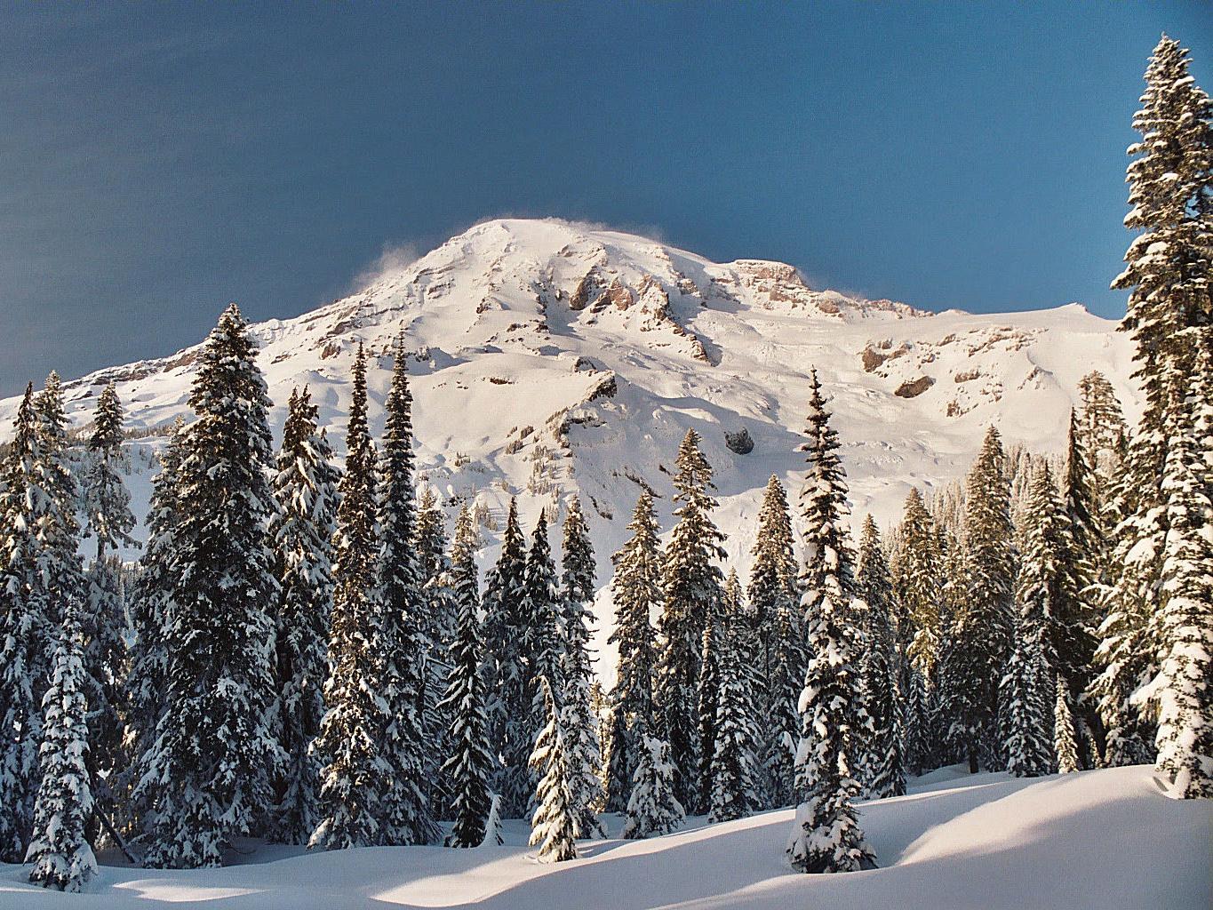



Picture caption
Picture caption
Picture caption
Notes:
Custom animation effects: grow and shrink picture
(Advanced)
Tip: This slide includes three small pictures and one large version of the top small picture. The small pictures are 1.88” high and 2.5” wide. The large picture is 7.5” high and 10” wide (the dimensions of the slide). Before following the procedures below, size each of the three pictures you will insert into the slide to 7.5” high by 10” wide. You will also need to use drawing guides to position your pictures on the slide.
To display and set the drawing guides, do the following:
On the Home tab, in the Slides group, click Layout, and then click Blank.
Right-click the slide background area, and then click Grid and Guides. In the Grid and Guides dialog box, under Guide settings, select Display drawing guides on screen. (Note: One horizontal and one vertical guide will display on the slide at 0.00, the default position. As you drag the guides, the cursor will display the new position.)
On the slide, do the following:
Press and hold CTRL, select the horizontal guide, and then drag it up to the 2.17 position.
Press and hold CTRL, select the horizontal guide, and then drag it down to the 2.17 position.
Press and hold CTRL, select the vertical guide, and then drag it right to the 3.50 position.
Press and hold CTRL, select the vertical guide, and then drag it left to the 2.50 position.
To reproduce the shape effects on this slide, do the following:
On the Home tab, in the Drawing group, click Shapes, and then under Rectangles click Snip Diagonal Corner Rectangle (fifth option from the left).
On the Home tab, in the Drawing group, click the arrow next to Shape Outline, and then click No Outline.
On the Home tab, in the Drawing group, click the arrow next to Shape Fill, point to Gradient, and then click More Gradients. In the Format Shape dialog box, in the left pane, click Fill, select Gradient fill in the Fill pane, and then do the following:
In the Type list, select Linear.
Click the button next to Direction, and then click Linear Right (first row, fourth option from the left).
Under Gradient stops, click Add or Remove until two stops appear in the drop-down list.
Also under Gradient stops, customize the gradient stops as follows:
Select Stop 1 from the list, and then do the following:
In the Stop position box, enter 0%.
Click the button next to Color, and then under Theme Colors click Black, Text 1 (first row, second option from the left).
In the Transparency box, enter 51%.
Select Stop 2 from the list, and then do the following:
In the Stop position box, enter 100%.
Click the button next to Color, and then under Theme Colors click Black, Text 1 (first row, second option from the left).
In the Transparency box, enter 85%.
Under Drawing Tools, on the Format tab, in the Size group, do the following:
In the Shape Height box, enter 1.5”.
In the Shape Width box, enter 8.42”.
Select the rectangle. On the Home tab, in the Clipboard group, click the arrow under Paste, and then click Duplicate. Repeat this process one more time for a total of three rectangles.
Drag the first rectangle and center it vertically on the top horizontal drawing guide (2.17).
Drag the second rectangle and center it vertically on the middle horizontal drawing guide (0.00).
Drag the third rectangle and center it vertically on the bottom horizontal drawing guide (2.17).
Press and hold CTRL, and then select all three rectangles. On the Home tab, in the Drawing group, click Arrange, point to Align, and then do the following:
Click Align to Slide.
Click Align Center.
To reproduce the picture effects on this slide, do the following:
On the Insert tab, in the Illustrations group, click Picture. In the Insert Picture dialog box, select a picture and then click Insert.
On the slide, select the picture. Under Picture Tools, on the Format tab, in the bottom right corner of the Size group, click the Size and Position dialog box launcher. In the Size and Position dialog box, on the Size tab, under Scale, clear Lock aspect ratio, and then under Size and rotate, do the following:
In the Height box, enter 1.88”.
In the Width box, enter 2.5”.
Under Picture Tools, on the Format tab, in the Picture Styles group, click the arrow next to Picture Border, and then do the following:
Under Theme Colors click Dark Blue, Text 2, Darker 25% (fifth row, fourth option from the left).
Point to Weight, and then click 1 ½ pt.
On the slide, drag the picture until it is centered at the intersection of the top horizontal drawing guide (2.17) and the left vertical drawing guide (2.50).
Select the picture. On the Home tab, in the Clipboard group, click the arrow under Paste, and then click Duplicate.
Right-click the second picture, and then select Change Picture. In the Insert Picture dialog box, select a picture and then click Insert.
On the slide, drag the second picture until it is centered at the intersection of the center horizontal drawing guide (0.00) and the left vertical drawing guide (2.50).
Select the second picture. On the Home tab, in the Clipboard group, click the arrow under Paste, and then click Duplicate.
Right-click the third picture, and then select Change Picture. In the Insert Picture dialog box, select a picture and then click Insert.
On the slide, drag the third picture until it is centered at the intersection of the bottom horizontal drawing guide (2.17) and the left vertical drawing guide (2.50).
To reproduce the text effects on this slide, do the following:
On the Insert tab, in the Text group, click Text Box. On the slide, drag to draw a text box.
Enter text for the first picture caption in the text box, and then select the text. On the Home tab, in the Font group, select Calibri from the Font list, select 18 from the Font Size list, click the arrow next to Font Color, and then under Theme Colors click White, Background 1 (first row, first option from the left).
Select the text box, and then drag the it to the right of the first picture, above the top horizontal drawing guide (2.17).
Select the text box. On the Home tab, in the Clipboard group, click the arrow under Paste, and then click Duplicate.
Click in the second text box, and then enter text for the second picture caption.
Select the second text box, and then drag the it to the right of the second picture, above the center horizontal drawing guide (0.00).
Select the second text box. On the Home tab, in the Clipboard group, click the arrow under Paste, and then click Duplicate.
Click in the third text box, and then enter text for the third picture caption.
Select the third text box, and then drag the it to the right of the third picture, above the bottom horizontal drawing guide (2.17).
To reproduce the animation effects on this slide, do the following:
On the Insert tab, in the Illustrations group, click Picture. In the Insert Picture dialog box, select the 7.5” x 10” version of the picture that fills the top small rectangle on the slide, and then click Insert.
On the Animations tab, in the Animations group, click Custom Animation.
On the slide, select the new large picture. In the Custom Animation task pane, do the following:
Click Add Effect, point to Exit, and then click More Effects. In the Add Exit Effect dialog box, under Basic, click Disappear, and then click OK. Under Modify: Disappear, in the Start list, select After Previous.
Click Add Effect, point to Emphasis, and then click More Effects. In the Add Emphasis Effect dialog box, under Basic, click Grow/Shrink, and then click OK. Under Modify: Grow/Shrink, do the following:
In the Start list, select After Previous.
In the Size list, in the Custom box, enter 25%, and then press ENTER.
Also in the Custom Animation task pane, click the arrow to the right of the second animation effect (grow/shrink effect), and then click Timing. In the Grow/Shrink dialog box, on the Timing tab, in the Speed box, enter 0.01 seconds.
With the large picture still selected on the slide, do the following in the Custom Animation task pane:
Click Add Effect, point to Entrance, and then click More Effects. In the Add Entrance Effect dialog box, under Basic, click Appear, and then click OK. Under Modify: Appear, in the Start list, select On Click.
Click Add Effect, point to Emphasis, and then click More Effects. In the Add Emphasis Effect dialog box, under Basic, click Grow/Shrink, and then click OK. Under Modify: Grow/Shrink, do the following:
In the Start list, select With Previous.
In the Size list, in the Custom box, enter 400%, and then press ENTER.
In the Speed list, select Medium.
Click Add Effect, point to Motion Paths, and then click Up. Under Modify: Up, do the following:
In the Start list, select With Previous.
In the Speed list, select Medium.
On the slide, select the up motion path. Point to the endpoint (red arrow) until the cursor becomes a two-headed arrow. Drag the endpoint to the intersection of the top horizontal drawing guide (2.17) and the left vertical drawing guide (2.50), at the center of the first small picture.
Right-click the up motion path, and then click Reverse Path Direction.
In the Custom Animation task pane, select the fifth animation effect (up motion path). Under Modify: Up, in the Path list, select Locked.
On the slide, select the large picture. In the Custom Animation task pane, do the following:
Click Add Effect, point to Emphasis, and then click More Effects. In the Add Emphasis Effect dialog box, under Basic, click Grow/Shrink, and then click OK. Under Modify: Grow/Shrink, do the following:
In the Start list, select On Click.
In the Size list, in the Custom box, enter 25%, and then press ENTER.
In the Speed list, select Medium.
Click Add Effect, point to Motion Paths, and then click Up. Under Modify: Up, do the following:
In the Start list, select With Previous.
In the Speed list, select Medium.
On the slide, select the second up motion path. Point to the endpoint (red arrow) until the cursor becomes a two-headed arrow. Drag the endpoint to the intersection of the top horizontal drawing guide (2.17) and the left vertical drawing guide (2.50), at the center of the first small picture.
In the Custom Animation task pane, select the seventh animation effect (second up motion path). Under Modify: Up, in the Path list, select Locked.
On the slide, select the large picture. In the Custom Animation task pane, do the following:
Click Add Effect, point to Exit, and then click More Effects. In the Add Exit Effect dialog box, under Basic, click Disappear, and then click OK.
Under Modify: Disappear, in the Start list, select After Previous.
On the slide, select the large picture. Press the LEFT ARROW key to position the picture off the left edge of the slide.
Right-click the slide background area, and then click Grid and Guides. In the Grid and Guides dialog box, under Guide settings, clear Display drawing guides on screen, and then click OK.
To reproduce the background effects on this slide, do the following:
On the Design tab, in the bottom right corner of the Background group, click the Format Background dialog box launcher. In the Format Background dialog box, click Fill in the left pane, select Gradient fill in the Fill pane, and then do the following:
In the Type list, select Linear.
In the Direction list, click Linear Up (second row, second option from the left).
Under Gradient stops, click Add or Remove until three stops appear in the drop-down list.
Also under Gradient stops, customize the gradient stops as follows:
Select Stop 1 from the list, and then do the following:
In the Stop position box, enter 0%.
Click the button next to Color, and then under Theme Colors click Dark Blue, Text 2, Darker 50% (sixth row, fourth option from the left).
Select Stop 2 from the list, and then do the following:
In the Stop position box, enter 50%.
Click the button next to Color, and then under Theme Colors click Dark Blue, Text 2, Lighter 40% (fourth row, fourth option from the left).
Select Stop 3 from the list, and then do the following:
In the Stop position box, enter 100%.
Click the button next to Color, and then under Theme Colors click Dark Blue, Text 2, Darker 25% (fifth row, fourth option from the left).

Slide 9



Topic one text label
Topic two text label
Topic three text label
Notes:
Custom animation effects: Shrink and position circular pictures
(Intermediate)
Tip: This slide design includes three large, circle-shaped pictures. Each picture has a 12” diameter and is larger than the slide. You will want to use drawing guides to reproduce the effects on this slide.
To display and set the drawing guides, do the following:
On the Home tab, in the Slides group, click Layout, and then click Blank.
On the View tab, in the Show/Hide group, select Ruler.
Right-click the slide background and select Grid and Guides. In the Grid and Guides dialog box, under Guide settings, select Display drawing guides on screen. (Note: One horizontal and one vertical guide will display on the slide at 0.00, the default position. As you drag the guides, the cursor will display the new position.)
Do the following on the slide:
Press and hold CTRL, select the vertical guide, and then drag it left to the 2.83 position.
Press and hold CTRL, select the vertical guide, and then drag it right to the 2.83 position.
Press and hold CTRL, select the horizontal guide, and then drag it up to the 0.83 position.
To reproduce the first animated picture effect on this slide, do the following:
On the Insert tab, in the Illustrations group, click Picture. In the Insert Picture dialog box, select a picture and then click Insert.
On the slide, select the picture. Under Picture Tools, on the Format tab, in the Picture Styles group, click Picture Shape, and then under Basic Shapes click Oval (first row, first option from the left).
Select the oval picture. Under Picture Tools, on the Format tab, in the bottom right corner of the Size group, click the Size and Position dialog box launcher. In the Size and Position dialog box, on the Size tab, resize or crop the picture as needed so that under Size and rotate, the Height box is set to 12” and the Width box is set to 12”. Resize the picture under Size and rotate by entering values into the Height and Width boxes. Crop the picture under Crop from by entering values into the Left, Right, Top, and Bottom boxes.
On the Home tab, in the Drawing group, click Arrange, point to Align, and then do the following:
Click Align to Slide.
Click Align Center.
Click Align Middle.
On the Animations tab, in the Animations group, click Custom Animation.
On the slide, select the picture. In the Custom Animation task pane, do the following:
Click Add Effect, point to Entrance, and then click More Effects. In the Add Entrance Effect dialog box, under Subtle, click Fade, and then click OK. Under Modify: Fade, do the following:
In the Start list, select With Previous.
In the Speed list, select Medium.
Click Add Effect, point to Emphasis, and then click More Effects. In the Add Emphasis Effect dialog box, under Basic, click Grow/Shrink, and then click OK. Under Modify: Grow/Shrink, do the following:
In the Start list, select After Previous.
In the Size list, in the Custom box, enter 20%, and then press ENTER.
In the Speed list, select Medium.
Click Add Effect, point to Motion Paths, and then click Left. Under Modify: Left, do the following:
In the Start list, select With Previous.
In the Speed list, select Medium.
In the Custom Animation task pane, select the third animation effect (left motion path for the first picture). On the slide, select the left motion path. Point to the endpoint (red arrow) of the selected motion path until the cursor becomes a two-headed arrow. Drag the endpoint to the intersection of the drawing guides in the upper left area of the slide (2.83 vertical left and 0.83 horizontal top).
To reproduce the second animated picture effect on this slide, do the following:
On the Insert tab, in the Illustrations group, click Picture. In the Insert Picture dialog box, select a picture and then click Insert.
On the slide, select the picture. Under Picture Tools, on the Format tab, in the Picture Styles group, click Picture Shape, and then under Basic Shapes click Oval (first row, first option from the left).
Select the oval picture. Under Picture Tools, on the Format tab, in the bottom right corner of the Size group, click the Size and Position dialog box launcher. In the Size and Position dialog box, on the Size tab, resize or crop the picture as needed so that under Size and rotate, the Height box is set to 12” and the Width box is set to 12”. Resize the picture under Size and rotate by entering values into the Height and Width boxes. Crop the picture under Crop from by entering values into the Left, Right, Top, and Bottom boxes.
On the Home tab, in the Drawing group, click Arrange, point to Align, and then do the following:
Click Align to Slide.
Click Align Center.
Click Align Middle.
On the Animations tab, in the Animations group, click Custom Animation.
On the slide, select the picture. In the Custom Animation task pane, do the following:
Click Add Effect, point to Entrance, and then click More Effects. In the Add Entrance Effect dialog box, under Subtle, click Fade, and then click OK. Under Modify: Fade, do the following:
In the Start list, select With Previous.
In the Speed list, select Medium.
Click Add Effect, point to Emphasis, and then click More Effects. In the Add Emphasis Effect dialog box, under Basic, click Grow/Shrink, and then click OK. Under Modify: Grow/Shrink, do the following:
In the Start list, select After Previous.
In the Size list, in the Custom box, enter 20%, and then press ENTER.
In the Speed list, select Medium.
Click Add Effect, point to Motion Paths, and then click Up. Under Modify: Up, do the following:
In the Start list, select With Previous.
In the Speed list, select Medium.
In the Custom Animation task pane, select the sixth animation effect (up motion path for the second picture). On the slide, point to the endpoint (red arrow) of the selected motion path until the cursor becomes a two-headed arrow. Drag the endpoint to the intersection of the drawing guides in the upper middle area of the slide (0.00 vertical and 0.83 horizontal top).
To reproduce the third animated picture effect on this slide, do the following:
On the Insert tab, in the Illustrations group, click Picture. In the Insert Picture dialog box, select a picture and then click Insert.
On the slide, select the picture. Under Picture Tools, on the Format tab, in the Picture Styles group, click Picture Shape, and then under Basic Shapes click Oval (first row, first option from the left).
Select the oval picture. Under Picture Tools, on the Format tab, in the bottom right corner of the Size group, click the Size and Position dialog box launcher. In the Size and Position dialog box, on the Size tab, resize or crop the picture as needed so that under Size and rotate, the Height box is set to 12” and the Width box is set to 12”. Resize the picture under Size and rotate by entering values into the Height and Width boxes. Crop the picture under Crop from by entering values into the Left, Right, Top, and Bottom boxes.
On the Home tab, in the Drawing group, click Arrange, point to Align, and then do the following:
Click Align to Slide.
Click Align Center.
Click Align Middle.
On the Animations tab, in the Animations group, click Custom Animation.
On the slide, select the picture. In the Custom Animation task pane, do the following:
Click Add Effect, point to Entrance, and then click More Effects. In the Add Entrance Effect dialog box, under Subtle, click Fade, and then click OK. Under Modify: Fade, do the following:
In the Start list, select With Previous.
In the Speed list, select Medium.
Click Add Effect, point to Emphasis, and then click More Effects. In the Add Emphasis Effect dialog box, under Basic, click Grow/Shrink, and then click OK. Under Modify: Grow/Shrink, do the following:
In the Start list, select After Previous.
In the Size list, in the Custom box, enter 20%, and then press ENTER.
In the Speed list, select Medium.
Click Add Effect, point to Motion Paths, and then click Right. Under Modify: Right, do the following:
In the Start list, select With Previous.
In the Speed list, select Medium.
In the Custom Animation task pane, select the ninth animation effect (right motion path for the third picture). On the slide, point to the endpoint (red arrow) of the selected motion path until the cursor becomes a two-headed arrow. Drag the endpoint to the intersection of the drawing guides in the upper right area of the slide (0.83 horizontal top and 2.83 vertical right).
To reproduce the animated text effects on this slide, do the following:
On the Insert tab, in the Text group, click Text Box. On the slide, drag to draw a text box.
Enter text in the text box, and then select the text. On the Home tab, in the Font group, select Candara from the Font list, select 24 from the Font Size list, click the arrow next to Font Color, and then under Theme Colors click White, Background 1 (first row, first option from the left).
On the Home tab, in the Paragraph group, click Center.
On the slide, select the text box. On the Home tab, in the Clipboard group, click the arrow under Paste, and then click Duplicate. Repeat this process once more for a total of three text boxes.
Click in the duplicate text boxes, and then edit the text.
Select the first text box, and then drag it on the slide so that it is centered on the left vertical drawing guide at 2.83 and below the horizontal drawing guide at 0.00.
Select the second text box, and then drag it on the slide so that it is centered on the vertical drawing guide at 0.00 and below the horizontal drawing guide at 0.00.
Select the third text box, and then drag it on the slide so that it is centered on the right vertical drawing guide at 2.83 and below the horizontal drawing guide at 0.00.
On the slide, select the first (left) text box. In the Custom Animation task pane, do the following:
Click Add Effect, point to Entrance, and then click More Effects. In the Add Entrance Effect dialog box, under Moderate, click Descend, and then click OK.
Under Modify: Descend, in the Start list, select With Previous.
Under Modify: Descend, in the Speed list, select Fast.
Also in the Custom Animation task pane, click the arrow to the right of the 10th animation effect (descend effect for the first text box), and then click Timing. In the Descend dialog box, on the Timing tab, in the Delay box, enter 2, and then click OK.
On the slide, select the second (center) text box. In the Custom Animation task pane, do the following:
Click Add Effect, point to Entrance, and then click More Effects. In the Add Entrance Effect dialog box, under Moderate, click Descend, and then click OK.
Under Modify: Descend, in the Start list, select With Previous.
Under Modify: Descend, in the Speed list, select Fast.
Also in the Custom Animation task pane, click the arrow to the right of the 10th animation effect (descend effect for the first text box), and then click Timing. In the Descend dialog box, on the Timing tab, in the Delay box, enter 3, and then click OK.
On the slide, select the third (right) text box. In the Custom Animation task pane, do the following:
Click Add Effect, point to Entrance, and then click More Effects. In the Add Entrance Effect dialog box, under Moderate, click Descend, and then click OK.
Under Modify: Descend, in the Start list, select With Previous.
Under Modify: Descend, in the Speed list, select Fast.
Also in the Custom Animation task pane, click the arrow to the right of the 10th animation effect (descend effect for the first text box), and then click Timing. In the Descend dialog box, on the Timing tab, in the Delay box, enter 4, and then click OK.
To reproduce the background effects on this slide, do the following:
On the Design tab, in the bottom right corner of the Background group, click the Format Background dialog box launcher. In the Format Background dialog box, in the left pane, click Fill. In the Fill pane, click Picture or text fill, and then under Insert From, click File. In the Insert Picture dialog box, select a picture and then click Insert.
Also the Format Background dialog box, in the left pane, click Picture. In the Picture pane, click the button next to Recolor, and then under Color Modes click Grayscale (first option from the left).

Slide 10
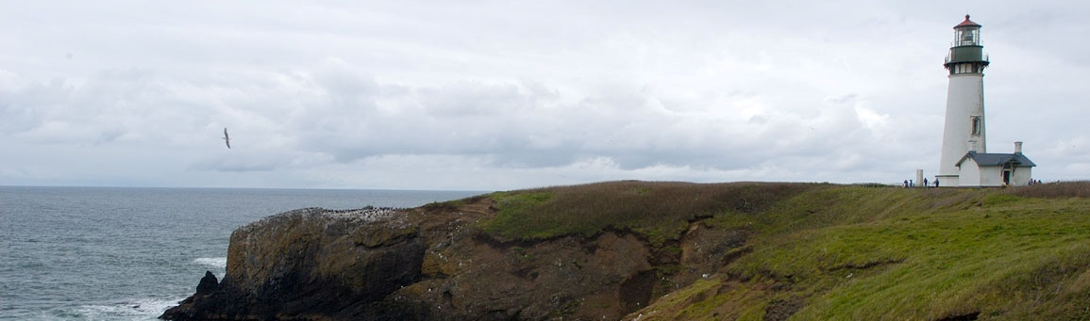
JAN
FEB
MAR
APR
MAY
JUN
Project title
Scheduled dates
Team members
Project title
Scheduled dates
Team members
Notes:
Timeline graphic with pictures
(Intermediate)
To reproduce the picture effects on this slide, do the following:
On the Home tab, in the Slides group, click Layout, and then click Blank.
On the Insert tab, in the Illustrations group, click Picture.
In the Insert Picture dialog box, select a picture and then click Insert.
Select the picture. Under Picture Tools, on the Format tab, in the bottom right corner of the Size group, click the Size and Position dialog box launcher.
In the Size and Position dialog box, on the Size tab, resize or crop the picture as needed so that under Size and rotate, the Height box is set to 2.65” and the Width box is set to 9”. Resize the picture under Size and rotate by entering values into the Height and Width boxes. Crop the picture under Crop from by entering values into the Left, Right, Top, and Bottom boxes.
Under Picture Tools, in the Format tab, in the Picture Styles group, click Picture Shape, and then under Rectangles click Round Same Side Corner Rectangle (eighth option from the left).
Drag the top yellow diamond adjustment handle slightly to the right to decrease the amount of rounding on the corners.
Under Picture Tools, in the Format tab, in the Picture Styles group, click Picture Effects, point to Shadow, and then under Inner click Inside Center (second row, second option from the left).
To reproduce the timeline effects on this slide, do the following:
On the Home tab, in the Drawing group, click Shapes, and then under Rectangles click Rectangle (first option from the left). On the slide, drag to draw a rectangle.
Select the rectangle. Under Drawing Tools, on the Format tab, in the Size group, do the following:
In the Shape Height box, enter 0.73”.
In the Shape Width box, enter 9”.
On the Home tab, in the bottom right corner of the Drawing group, click the Format Shape dialog box launcher. In the Format Shape dialog box, click Fill in the left pane, select Solid fill in the Fill pane, and then do the following:
Click the button next to Color, and then under Theme Colors click Black, Text 1, Lighter 35% (third row, second option from the left).
In the Transparency box, enter 20%.
Also in the Format Shape dialog box, click Line Color in the left pane, and then in the right pane, select No line.
Also in the Format Shape dialog box, click Shadow in the left pane. In the right pane, click the button next to Presets, and then under Inner click Inside Center (second row, second option from the left).
Drag the rectangle onto the bottom of the picture.
Press and hold SHIFT and select the rectangle and the picture. On the Home tab, in the Drawing group, click Arrange, point to Align, and then do the following:
Click Align Selected Objects.
Click Align Center.
Click Align Top.
Click Align to Slide.
Click Align Center.
To reproduce the month labels for the timeline, do the following:
On the Insert tab, in the Text group, click Text Box, and then on the slide, drag to draw the text box.
Enter text in the text box (in this example the text is “JAN”), select the text, and then on the Home tab, in the Font group, select Gil Sans MT Condensed from the Font list, select 18 from the Font Size list, click the arrow next to Font Color, and then under Theme Colors click White, Background 1, Darker 35% (fifth row, first option from the left).
On the Home tab, in the Paragraph group, click Center to center the text in the text box.
Select the text box. On the Home tab, in the Clipboard group, click the arrow under Paste, and then click Duplicate. Repeat the process until there is a total of six text boxes.
On the slide, drag the text boxes onto the rectangle to form a timeline.
On the Home tab, in the Editing group, click Select, and then click Selection Pane. In the Selection and Visibility pane, press and hold CTRL and select all six text boxes and the rectangle.
On the Home tab, in the Drawing group, click Arrange, point to Align, and then do the following:
Click Align Selected Objects.
Click Align Middle.
In the Selection and Visibility pane, press and hold CTRL and cancel the selection of the rectangle, keeping the text boxes selected. On the Home tab, in the Drawing group, click Arrange, point to Align, and then do the following:
Click Align to Slide.
Click Distribute Horizontally.
To change the text in the duplicate text boxes, click in each text box and edit the text.
To change the color of the second text box from the left, select the text box, and then on the Home tab, in the Font group, click the arrow next to Font Color, and then under Theme Colors click White, Background 1 (first row, first option from the left).
To reproduce the vertical line with text effects on this slide, do the following:
On the Home tab, in the Drawing group, click Shapes, and then under Lines click Line (first option from the left).
Press and hold SHIFT, and then drag on the slide to draw a straight, vertical line.
Select the line. Under Drawing Tools, on the Format tab, in the Size group, in the Shape Width box, enter 1.2”.
On the Home tab, in the bottom right corner of the Drawing group, click the Format Shape dialog box launcher. In the Format Shape dialog box, click Line Color in the left pane, and then do the following in the right pane:
Select Solid line.
Click the button next to Color, and then under Theme Colors click White, Background 1, Darker 25% (fourth row, first option from the left).
Also in the Format Shape dialog box, click Line Style in the left pane, and then do the following in the right pane:
In the Width box, enter 0.75 pt.
Under Arrow Settings, click the button next to Begin type, and then click Oval Arrow (second row, third option from the left).
Click the button next to Begin size, and then click Arrow L Size 1 (first row, first option from the left).
Click the button next to End type, and then enter Oval Arrow (second row, third option from the left).
Click the button next to End size, and then enter Arrow R Size 1 (first row, first option from the left).
On the Home tab, in the Clipboard group, click the arrow under Paste, and then click Duplicate.
Select the duplicate line. Under Drawing Tools, on the Format tab, in the Size group, in the Shape Width box, enter 2.6”.
Press and hold SHIFT and select both lines. On the Home tab, in the Drawing group, click Arrange, and then do the following:
Point to Align, and then click Align Selected Objects.
Point to Align, and then click Align Center.
Drag both lines together on the slide to position them under one of the timeline month labels.
Press and hold SHIFT and select both lines and the text box they are under. On the Home tab, in the Drawing group, click Arrange, and then do the following:
Click Align Selected Objects.
Click Align Center.
On the Insert tab, in the Text group, click Text Box, and then on the slide, drag to draw the text box.
Enter text in the text box, select the text, and then on the Home tab, in the Font group, select Gill Sans MT from the Font list, select 20 from the Font Size list, and then click the arrow next to Font Color and click White, Background 1 (first row, first option from the left).
On the Home tab, in the Paragraph group, click Align Text Left to align the text left in the text box.
On the slide, drag the text box to position it to the right of the vertical line.
To reproduce the background on this slide, do the following:
Right-click the slide background area, and then click Format Background. In the Format Background dialog box, click Fill in the left pane, select Gradient fill in the Fill pane, and then do the following:
In the Type list, select Linear.
Click the button next to Direction, and then click Linear Down (first row, second option from the left).
Under Gradient stops, click Add or Remove until two stops appear in the drop-down list.
Also under Gradient stops, customize the gradient stops that you added as follows:
Select Stop 1 from the list, and then do the following:
In the Stop position box, enter 50%.
Click the button next to Color, and then under Theme Colors click Black, Text 1 (first row, second option from the left).
Select Stop 2 from the list, and then do the following:
In the Stop position box, enter 99%.
Click the button next to Color, and then under Theme Colors click Black, Text 1, Lighter 35% (third row, second option from the left).

Slide 11




first line of text goes here
second line of text goes here
third line of text goes here
fourth line of text goes here
Notes:
Custom animation effects: buttons grow and turn on path
(Advanced)
To reproduce the curved shape on this slide, do the following:
On the Home tab, in the Slides group, click Layout, and then click Blank.
On the Home tab, in the Drawing group, click Shapes, and then under Lines click Freeform (11th option from the left).
On the slide, do the following to draw the freeform line:
Click the first point on the upper left corner of the slide.
Click the second point on the bottom edge of the slide, slightly to the left of the middle.
Click the third point on the lower left corner of the slide.
Double-click the fourth and final point on the first point, on the upper left corner of the slide.
Right-click the freeform shape, and then click Edit Points. Right-click the diagonal line, and then click Curved Segment. (Note: Your segment may not look as curved as in the example above.)
Select the freeform shape. On the Home tab, in the Drawing group, click the arrow next to Shape Fill, and then under Theme Colors click White, Background 1 (first row, first option from the left).
On the Home tab, in the Drawing group, click the arrow next to Shape Outline, and then click No Outline.
To reproduce the background effects on this slide, do the following:
Right-click the slide background area, and then click Format Background. In the Format Background dialog box, click Fill in the left pane, select Gradient fill in the Fill pane, and then do the following:
In the Type list, select Linear.
Click the button next to Direction, and then click Linear Diagonal (second row, third option from the left).
Under Gradient stops, click Add or Remove until two stops appear in the drop-down list.
Also under Gradient stops, customize the gradient stops that you added as follows:
Select Stop 1 from the list, and then do the following:
In the Stop position box, enter 0%.
Click the button next to Color, and then under Theme Colors click White, Background 1 (first row, first option from the left).
Select Stop 2 from the list, and then do the following:
In the Stop position box, enter 100%.
Click the button next to Color, click More Colors, and then in the Colors dialog box, on the Custom tab, enter values for Red: 230, Green: 230, Blue: 230.
To reproduce the picture and text effects on this slide, do the following:
On the Insert tab, in the Illustrations group, click Picture. In the Insert Picture dialog box, select a picture, and then click Insert.
On the slide, select the picture. Under Picture Tools, on the Format tab, in the Picture Styles group, click Picture Shape, and then under Basic Shapes click Oval (first option from the left).
With the picture still selected, under Picture Tools, on the Format tab, in the bottom right corner of the Size group, click the Size and Position dialog box launcher. In the Size and Position dialog box, on the Size tab, resize or crop the picture as needed so that under Size and rotate, the Height box is set to 1.2” and the Width box is set to 1.2”. Resize the picture under Size and rotate by entering values into the Height and Width boxes. Crop the picture under Crop from by entering values into the Left, Right, Top, and Bottom boxes.
Under Picture Tools, on the Format tab, in the Picture Styles group, click the arrow next to Picture Effects, point to Bevel, and then under Bevel click Circle (first row, first option from the left).
Under Picture Tools, on the Format tab, in the Picture Styles group, click Picture Effects, point to Bevel, and then click 3-D Options. In the Format Picture dialog box, click 3-D Format in the left pane, and then do the following in the 3-D Format pane, under Surface:
Click the button next to Material, and then under Standard click Metal (fourth option from the left).
Click the button next to Lighting, and then under Neutral click Contrasting (second row, second option from the left).
In the Angle box, enter 25°.
Also in the Format Picture dialog box, click Shadow in the left pane. In the Shadow pane, click the button next to Presets, under Outer click Offset Diagonal Bottom Left (first row, third option from the left), and then do the following:
In the Transparency box, enter 77%.
In the Size box, enter 100%.
In the Blur box, enter 10 pt.
In the Angle box, enter 141°.
In the Distance box, enter 10 pt.
On the slide, drag the picture onto the curve, near the top.
On the Insert tab, in the Text group, click Text Box. On the slide, drag to draw the text box.
Enter text in the text box and select it. On the Home tab, in the Font group, do the following:
In the Font list, select Corbel.
In the Font Size box, enter 22.
Click the arrow next to Font Color, and then under Theme Colors click White, Background 1, Darker 50% (sixth row, first option from the left).
On the Home tab, in the Paragraph group, click Align Text Left to align the text left in the text box.
On the slide, drag the text box to the right of the picture.
To reproduce the animation effects on this slide, do the following:
It will help to zoom out in order to view the area off the slide. On the View tab, in the Zoom group, click Zoom. In the Zoom dialog box, select 33%.
On the Animations tab, in the Animations group, click Custom Animation.
On the slide, select the picture. In the Custom Animation task pane, do the following:
Click Add Effect, point to Entrance, and then click More Effects. In the Add Entrance Effect dialog box, under Moderate, click Grow & Turn.
Select the animation effect (grow & turn effect for the picture). Under Modify: Grow & Turn, do the following:
In the Start list, select With Previous.
In the Speed list, select Fast.
On the slide, select the picture. In the Custom Animation task pane, click Add Effect, point to Motion Paths, point to Draw Custom Path, and then click Curve.
On the slide, do the following to create the custom motion path:
Click the first point in the center of the picture.
Click the second point in the middle of the curve.
Double-click the third point off the bottom edge of the slide.
In the Custom Animation task pane, select the second animation effect (motion path for the picture), and then under Modify: Custom Path, do the following:
In the Start list, select With Previous.
In the Speed list, select Fast.
On the slide, right-click the motion path and then click Reverse Path Direction.
On the slide, select the text box. In the Custom Animation task pane, do the following:
Click Add Effect, point to Entrance, and then click More Effects. In the Add Entrance Effect dialog box, under Subtle, click Fade.
Select the third animation effect (fade effect for the text box). Under Modify: Fade, do the following:
In the Start list, select After Previous.
In the Speed list, select Fast.
To reproduce the other animated pictures and text boxes on this slide, do the following:
On the Home tab, in the Editing group, click Select, and then click Selection Pane.
On the slide, press and hold CTRL and then select the picture and the text box. On the Home tab, in the Clipboard group, click the arrow under Paste, and then click Duplicate.
In the Selection and Visibility pane, select the duplicate picture and text box. On the slide, drag them onto the curve below the first group.
In the Custom Animation task pane, select the fifth animation effect (motion path for the second picture). On the slide, point to the starting point (green arrow) until the cursor becomes a two-headed arrow. Drag the starting point below the bottom edge of the slide, to the same position as the starting point for the first motion path. (Note: The endpoint of the second motion path should still be in the middle of the second picture.)
On the slide, right-click the second picture and then click Change Picture. In the Insert Picture dialog box, select a picture, and then click Insert.
With the picture still selected, under Picture Tools, on the Format tab, in the bottom right corner of the Size group, click the Size and Position dialog box launcher. In the Size and Position dialog box, on the Size tab, resize or crop the picture as needed so that under Size and rotate, the Height box is set to 1.2” and the Width box is set to 1.2”. Resize the picture under Size and rotate by entering values into the Height and Width boxes. Crop the picture under Crop from by entering values into the Left, Right, Top, and Bottom boxes.
Click in the text box and edit the text.
Repeat steps 1-7 two more times to reproduce the third and fourth pictures and text boxes with animation effects.

Slide 12
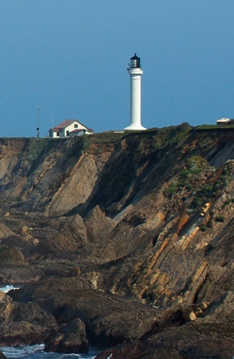
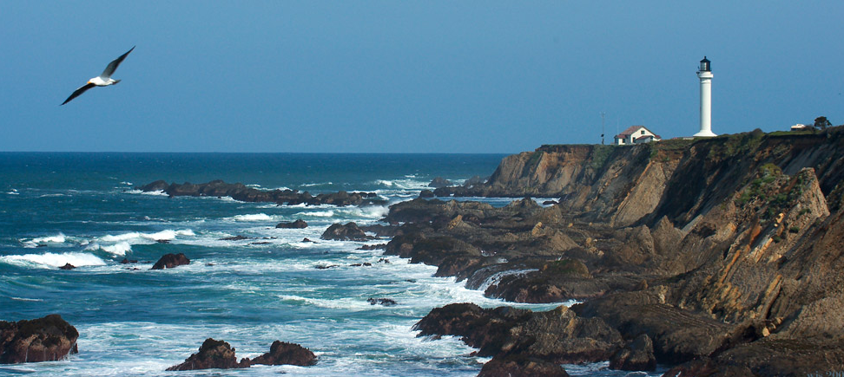
Statement or caption
Notes:
Custom animation effects: recolored picture with full-color section and motion path
(Advanced)
To reproduce the picture effects on this slide, do the following:
On the Home tab, in the Slides group, click Layout and then click Blank.
On the Insert tab, in the Illustrations group, click Picture. In the Insert Picture dialog box, select a picture, and then click Insert.
Select the picture. Under Picture Tools, on the Format tab, in the bottom right corner of the Size group, click the Size and Position dialog box launcher. In the Size and Position dialog box, on the Size tab, resize or crop the picture as needed so that under Size and rotate, the Height box is set to 3.58” and the Width box is set to 8”. Resize the picture under Size and rotate by entering values into the Height and Width boxes. Crop the picture under Crop from by entering values into the Left, Right, Top, and Bottom boxes.
Under Picture Tools, on the Format tab, in the Adjust group, click Recolor, and then under Dark Variations click Text color 2 Dark (first option from the left).
Under Picture Tools, on the Format tab, in the Picture Styles group, click Picture Effects, point to Shadow, and then under Inner click Inside Diagonal Top Left (first row, first option from the left).
Drag the picture so that it is positioned above the middle of the slide.
On the Home tab, in the Clipboard group, click the arrow next to Paste, and then click Duplicate.
Press and hold CTRL and select both pictures on the slide. On the Home tab, in the Drawing group, click Arrange, point to Align, and then do the following:
Click Align to Slide.
Click Align Center.
Click Align Selected Objects.
Click Align Middle.
Click the slide background area to cancel the selection of both pictures. Select the duplicate (top) picture. Under Picture Tools, on the Format tab, in the bottom right corner of the Size group, click the Size and Position dialog box launcher. In the Size and Position dialog box, on the Size tab, under Crop from, enter values into the Left and Right boxes so that under Size and rotate, and the Width box is set to 2.33”. (Note: For best results, crop the duplicate picture to tightly focus on a single element in the original picture.)
Under Picture Tools, on the Format tab, in the Adjust group, click Recolor, and then under No Recolor click No Recolor.
On the Home tab, in the Drawing group, click Shapes, and then under Rectangles click Rectangle (first option from the left). On the slide, drag to draw a rectangle.
Select the rectangle. Under Drawing Tools, on the Format tab, in the Size group, do the following:
In the Shape Height box, enter 7.5”.
In the Shape Width box, enter 2.33”.
Under Drawing Tools, on the Format tab, in the Shape Styles group, click the arrow next to Shape Fill, point to Gradient, and then click More Gradients. In the Format Shape dialog box, click Fill in the left pane, select Gradient fill in the Fill pane, and then do the following:
In the Type list, select Linear.
Click the button next to Direction, and then click Linear Down (first row, second option from the left).
Under Gradient stops, click Add or Remove until two stops appear in the drop-down list.
Also under Gradient stops, customize the gradient stops that you added as follows:
Select Stop 1 from the list, and then do the following:
In the Stop position box, enter 0%.
Click the button next to Color, then under Theme Colors click White, Background 1 (first row, first option from the left).
In the Transparency box, enter 55%.
Select Stop 2 from the list, and then do the following:
In the Stop position box, enter 100%.
Click the button next to Color, and then under Theme Colors click White, Background 1 (first row, first option from the left).
In the Transparency box, enter 100%.
On the slide, drag the rectangle to cover the duplicate picture.
Select the rectangle. On the Home tab, in the Drawing group, click Arrange, and then do the following:
Point to Align, and then click Align to Slide.
Point to Align, and then click Align Middle.
Click Send Backward.
On the Home tab, in the Drawing group, click Shapes, and then under Rectangles click Rectangle (first option from the left). On the slide, drag to draw another rectangle.
Select the rectangle. Under Drawing Tools, on the Format tab, in the Size group, do the following:
In the Shape Height box, enter 4”.
In the Shape Width box, enter 2.67”.
Under Drawing Tools, on the Format tab, in the Shape Styles group, click the arrow next to Shape Fill, point to Gradient, and then click More Gradients. In the Format Shape dialog box, click Fill in the left pane. In the Fill pane, select No fill.
Also in the Format Shape dialog box, click Line Color in the left pane, select Solid line in the Line Color pane, and then do the following:
Click the button next to Color, and then under Theme Colors click White, Background 1 (first row, first option from the left).
In the Transparency box, enter 70%.
Also in the Format Shape dialog box, click Line Style in the left pane, and then do the following in the Line Style pane:
In the Width box, enter 0.75 pt.
Click the button next to Dash type, and then click Square Dot (third option from the top).
Drag the dotted rectangle on top of the small, full-color picture.
Press and hold SHIFT and select the dotted rectangle, the small picture, and the large picture on the slide. On the Home tab, in the Drawing group, click Arrange, point to Align, and then do the following:
Click Align Selected Objects.
Click Align Middle.
On the Insert tab, in the Text group, click Text Box, and then on the slide, drag to draw the text box.
Enter text in the text box, select the text, and then on the Home tab, in the Font group, select Gill Sans MT Condensed from the Font list, select 24 from the Font Size list, click the button next to Font Color, and then under Theme Colors click White, Background 1 (first row, first option from the left).
On the Home tab, in the Paragraph group, click Center to center the text within the text box.
On the slide, drag the text box below the dotted rectangle.
To reproduce the background effects on this slide, do the following:
Right-click the slide background area, and then click Format Background. In the Format Background dialog box, click Fill in the left pane, and then select Solid fill in the Fill pane.
Also in the Fill pane, click the button next to Color, and then under Theme Colors click Black, Text 1, Lighter 15% (fifth row, second option from the left).
To reproduce the animation effects on this slide, do the following:
To view the area beyond the slide, on the View tab, click Zoom, and then in the Zoom dialog box, in the Percent box, enter 70%. (Note: Make sure that Fit is not selected in the Zoom dialog box.)
On the Animations tab, in the Animations group, click Custom Animation.
On the slide, select the dotted rectangle. In the Custom Animation task pane, click Add Effect, point to Motion Paths, point to Draw Custom Path, and then click Freeform.
Press and hold SHIFT to conform the path to a straight, horizontal line, and then do the following on the slide:
Click the center of the dotted rectangle to create the first motion-path point.
Click approximately ½” beyond the right edge of the rectangle to create the second motion-path point.
Double-click approximately 2” beyond the left edge of the slide to create the third and final motion-path point.
On the slide, right-click the freeform motion path, and then click Reverse Path Direction.
On the slide, select the freeform motion path. In the Custom Animation task pane, under Modify: Custom Path, in the Start list, select With Previous.
On the slide, select the gradient-filled rectangle. In the Custom Animation task pane, do the following:
Click Add Effect, point to Entrance, and then click More Effects. In the Add Entrance Effect dialog box, under Subtle, click Fade, and then click OK.
Under Modify: Fade, in the Start list, select With Previous.
Under Modify: Fade, in the Speed list, select Very Fast.
Click Add Effect, point to Motion Paths, and then click Down.
Under Modify: Down, in the Start list, select With Previous.
Under Modify: Down, in the Speed list, select Medium.
On the slide, right-click the down motion path and click Reverse Path Direction.
On the slide, select the smaller, full-color picture. In the Custom Animation task pane, do the following:
Click Add Effect, point to Entrance, and then click More Effects. In the Add Entrance Effect dialog box, under Subtle, click Fade, and then click OK.
Under Modify: Fade, in the Start list, select With Previous.
Under Modify: Fade, in the Speed list, select Very Fast.
Right-click the picture fade effect in the pane, and then click Timing. In the Fade dialog box, on the Timing tab, in the Delay box, enter 1.5.
On the slide, select the text box. In the Custom Animation task pane, do the following:
Click Add Effect, point to Entrance, and then click More Effects. In the Add Entrance Effect dialog box, under Moderate, click Descend, and then click OK.
Under Modify: Descend, in the Start list, select With Previous.
Under Modify: Descend, in the Speed list, select Fast.

Slide 13

Shifting Phenology
Notes:
Asset Type: Assessment
Notes for Teacher - < Information for further reference or explanation >
Suggestions: <Ideas/ Images/ Animations / Others – To make better representation of the content >
Details of Multimedia Objects (Image/audio/ Video/Animation) used in this slide -
1. <Short Description> - <SOURCE TYPE> <SOURCE URL>
e.g. Gandhiji- CR FREE CREATIVE COMMONS SEARCH - http://en.wikipedia.org/wiki/File:Portrait_Gandhi.jpg
Source Types -
SSSVV GALLERY
ORIGINAL (SELF CLICKED)
ORIGINAL (USING SHAPES/Ms PPT FEATURES)
ORIGINAL (USING PHOTOSHOP/HAND DRAWN SKETCH)
CR FREE CREATIVE COMMONS SEARCH
SSSVV AUTHORIZED LINKS
Others

